Slide 1
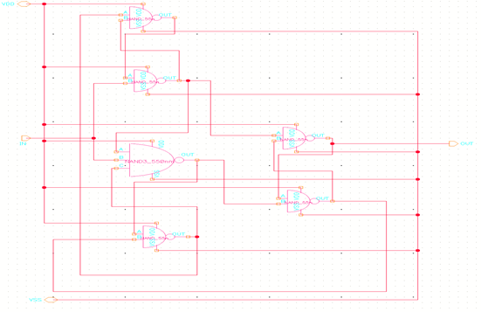
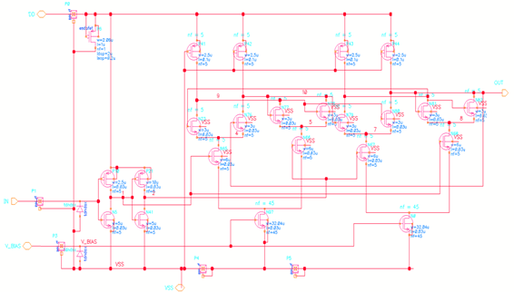
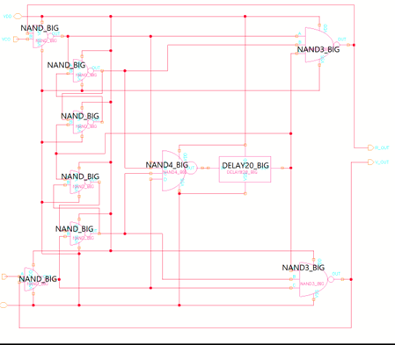
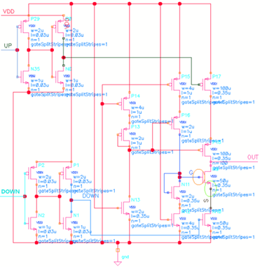
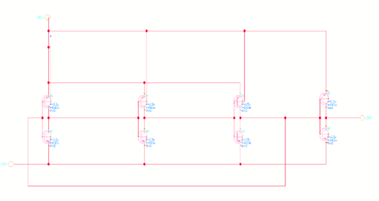
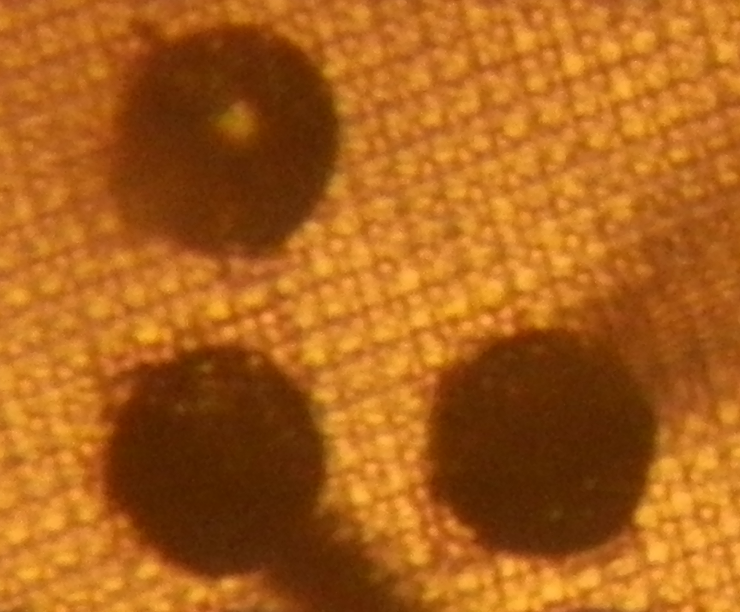
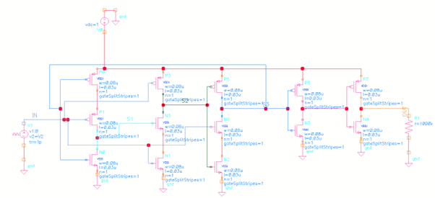
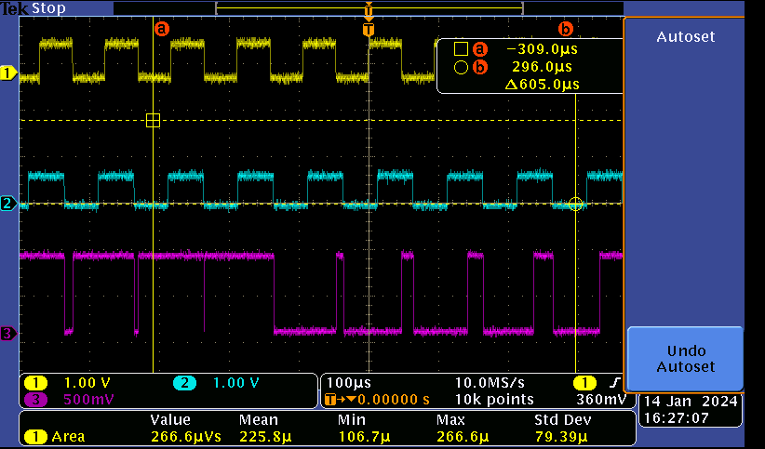
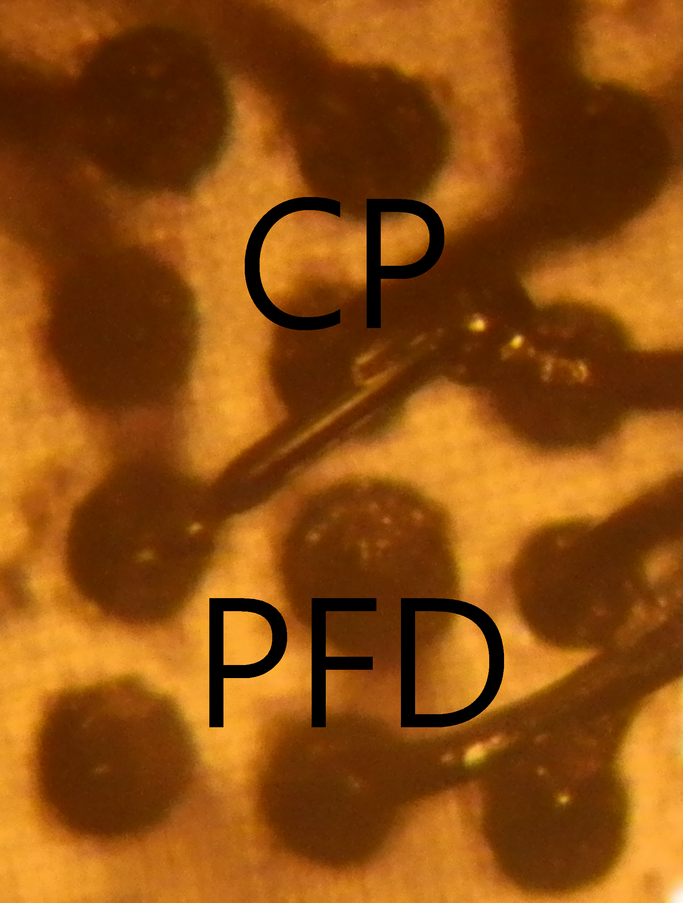
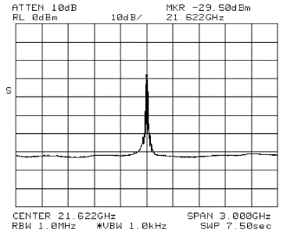
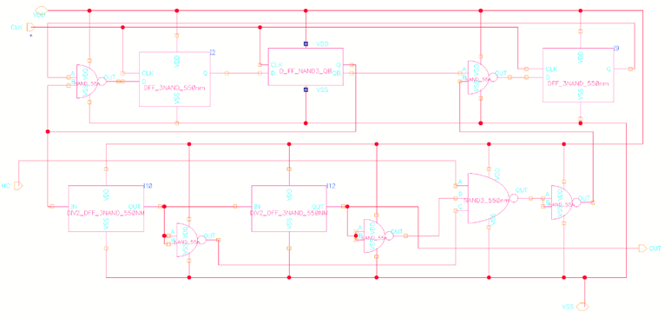
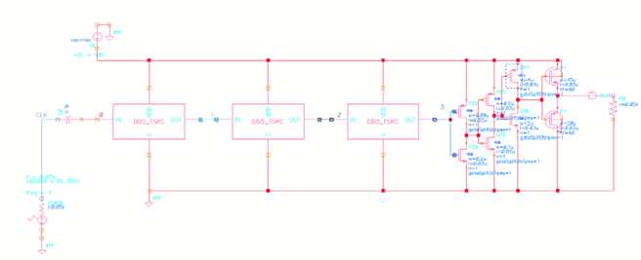
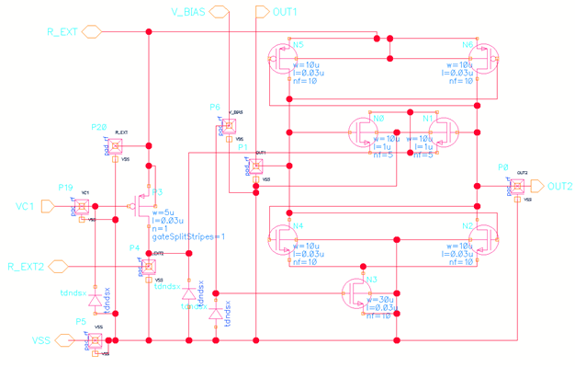
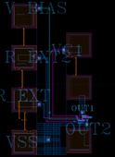
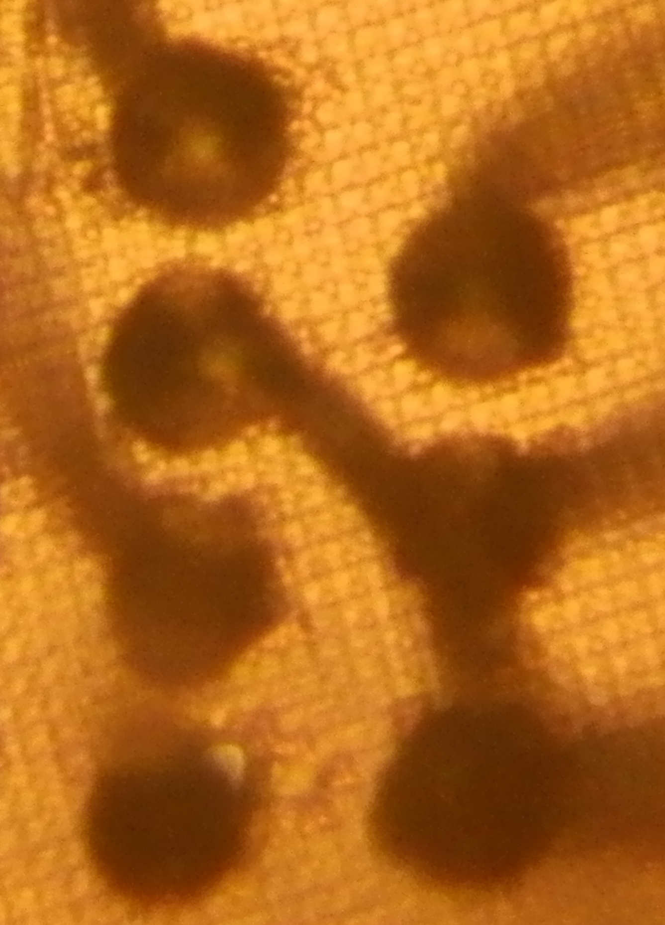
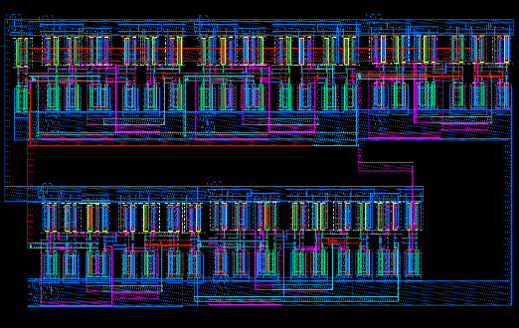
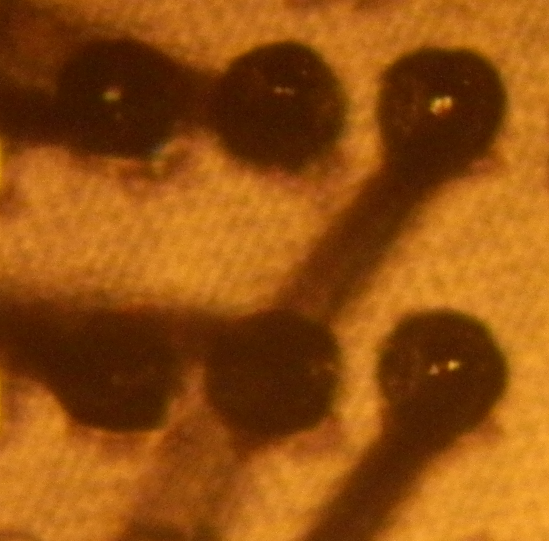
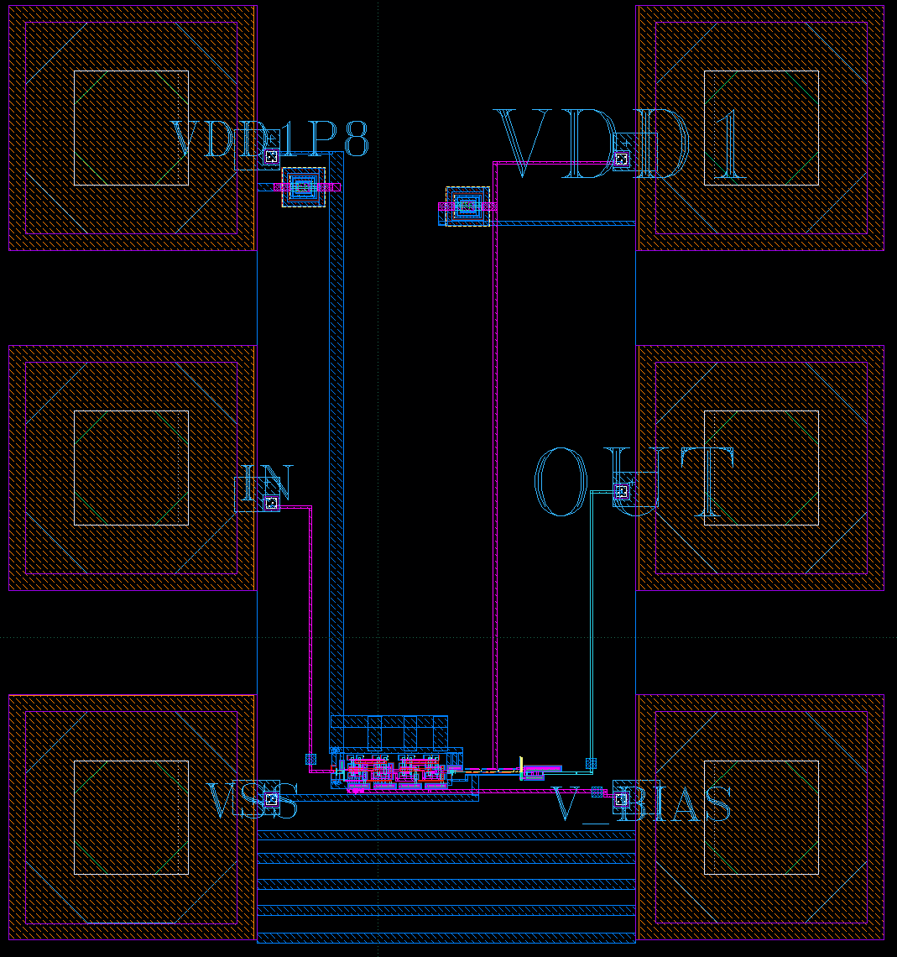
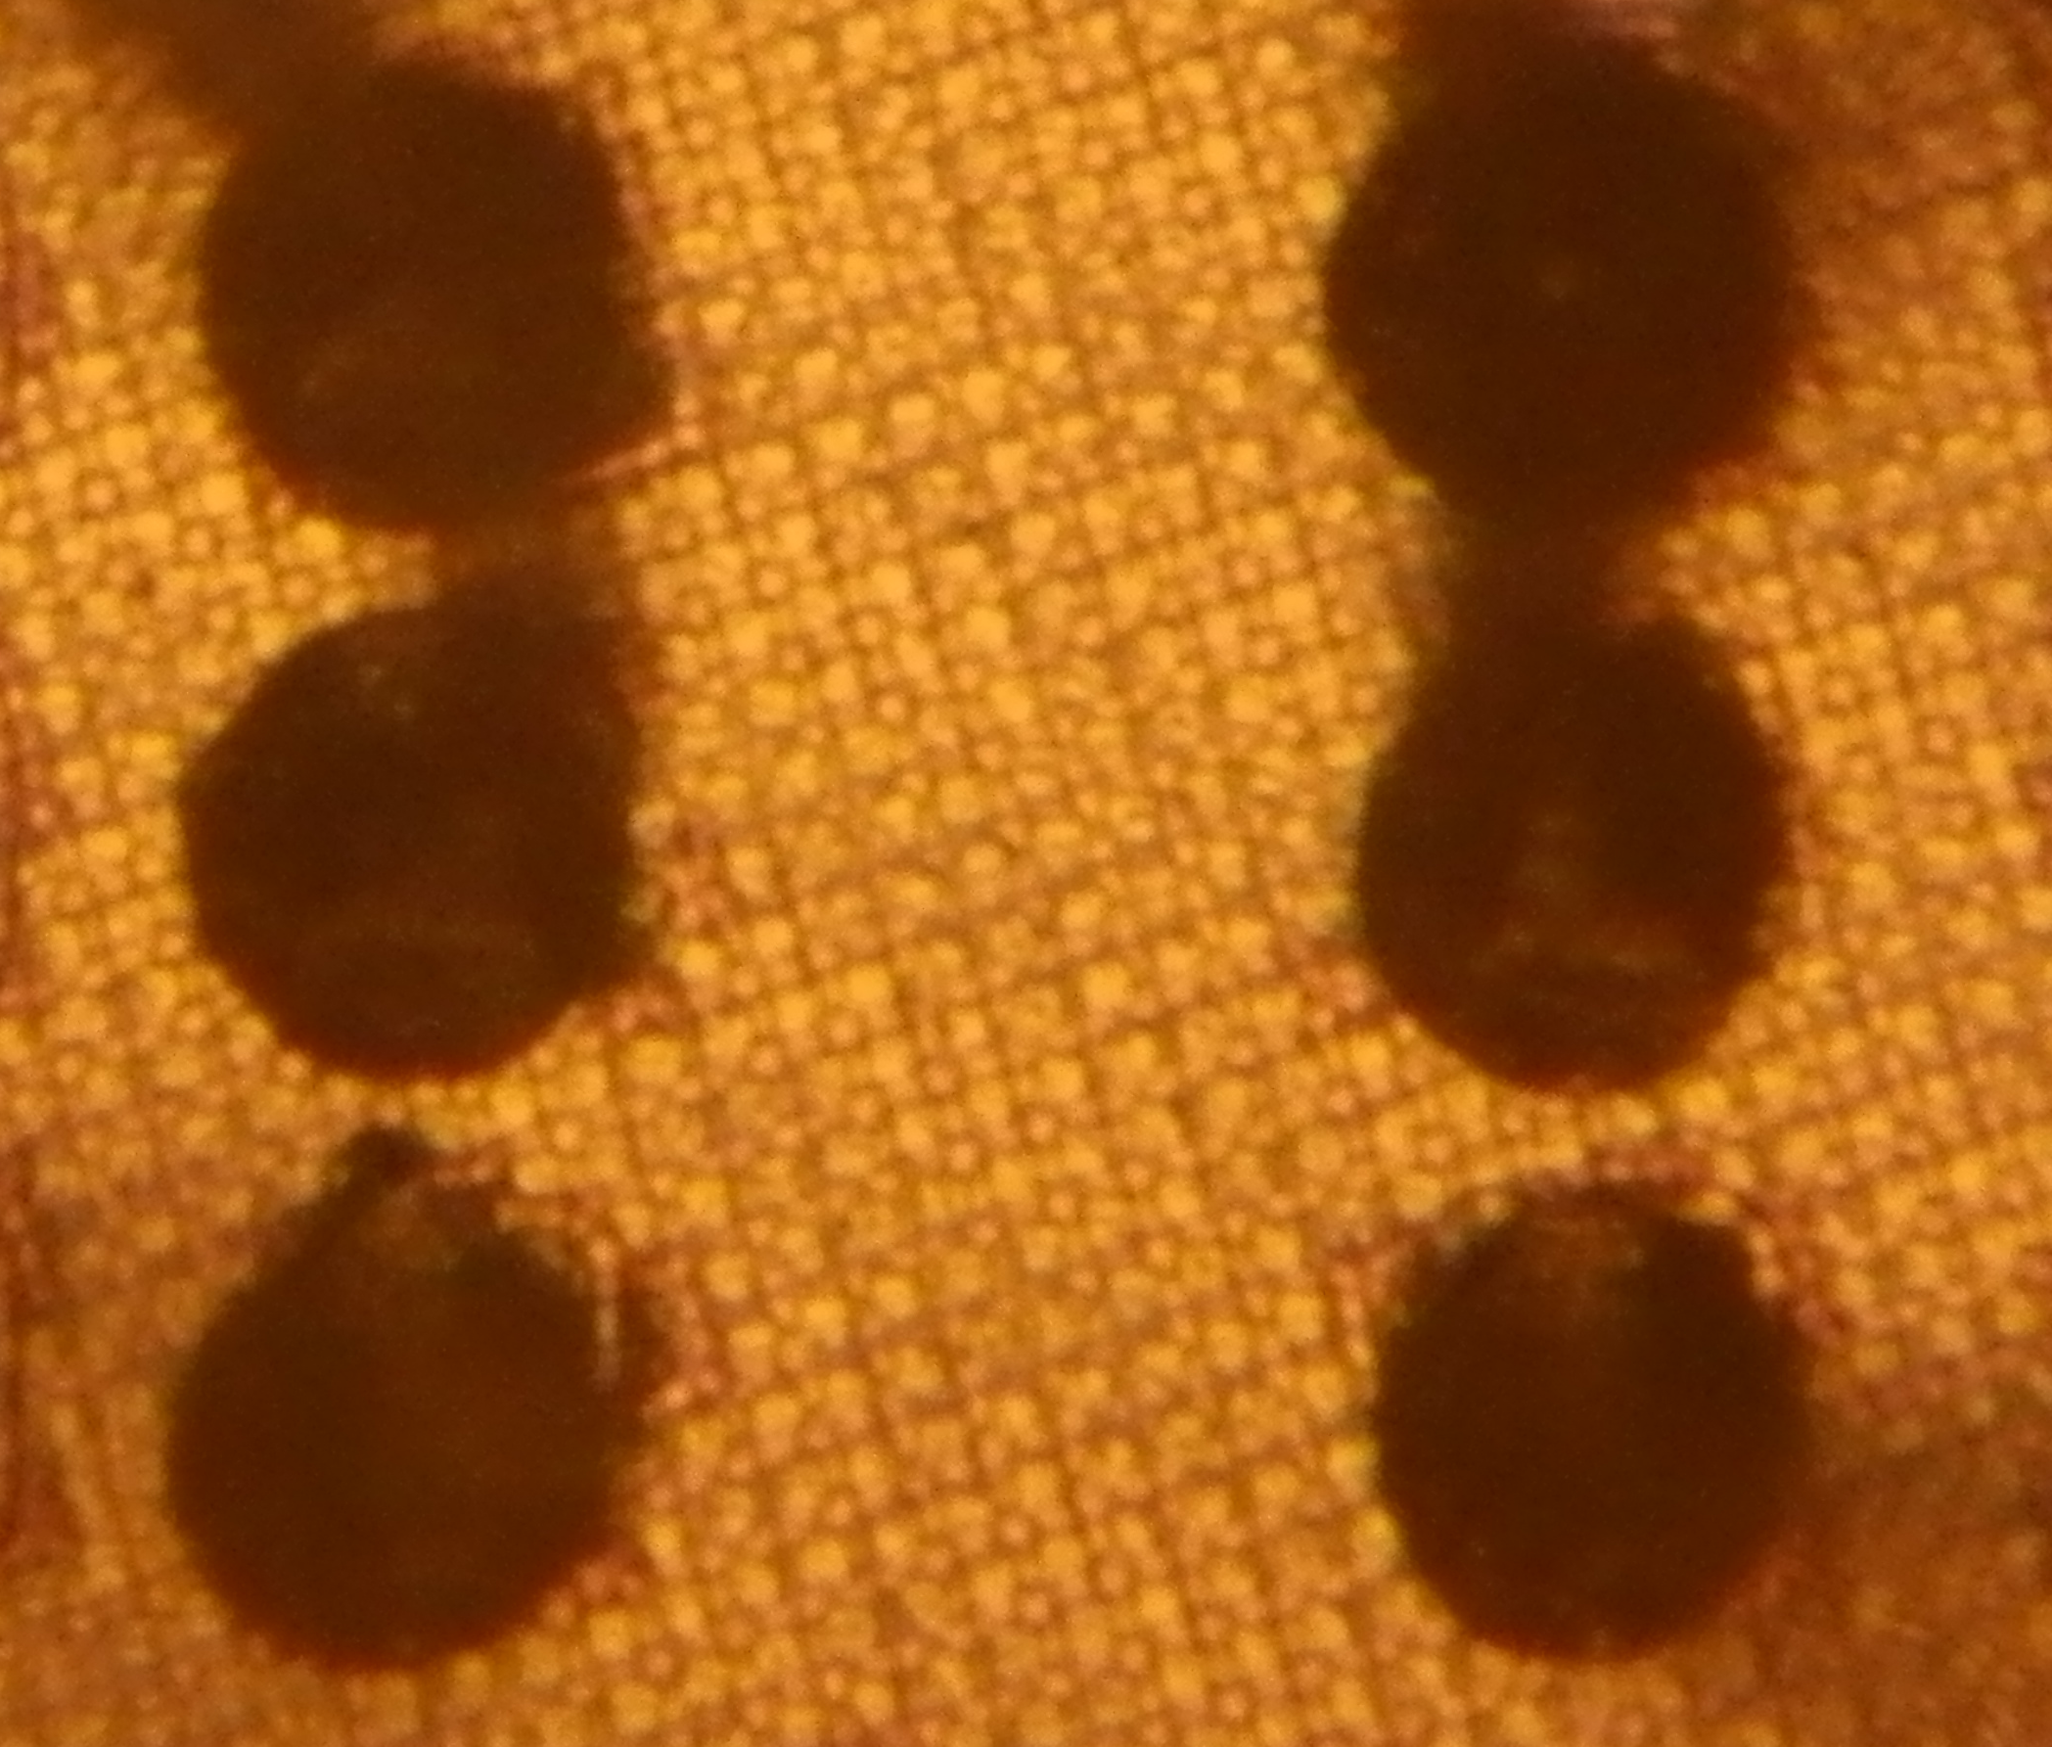
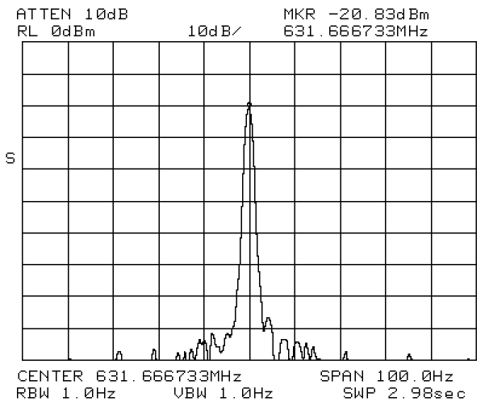
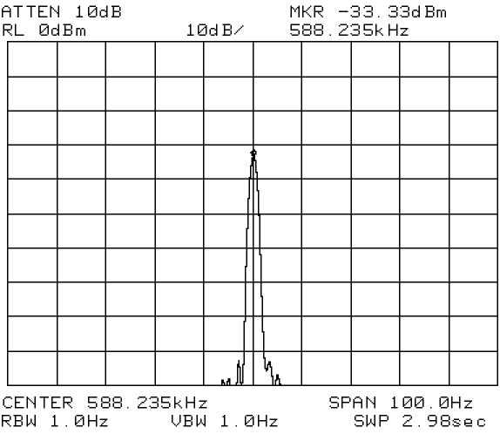
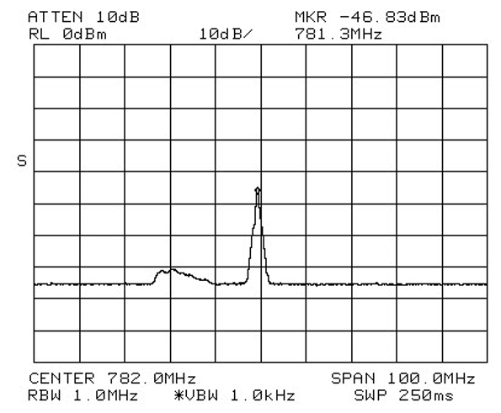
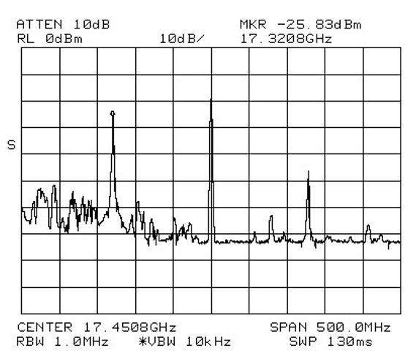
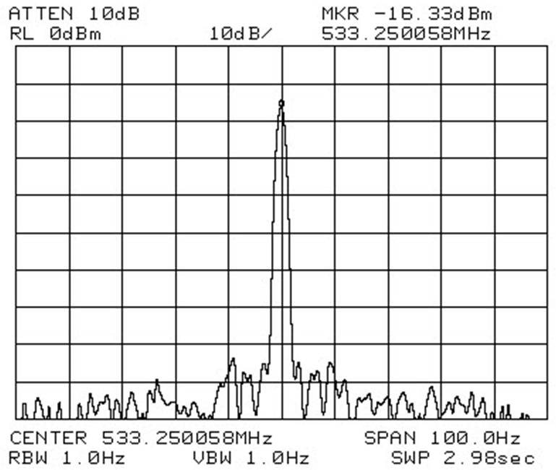
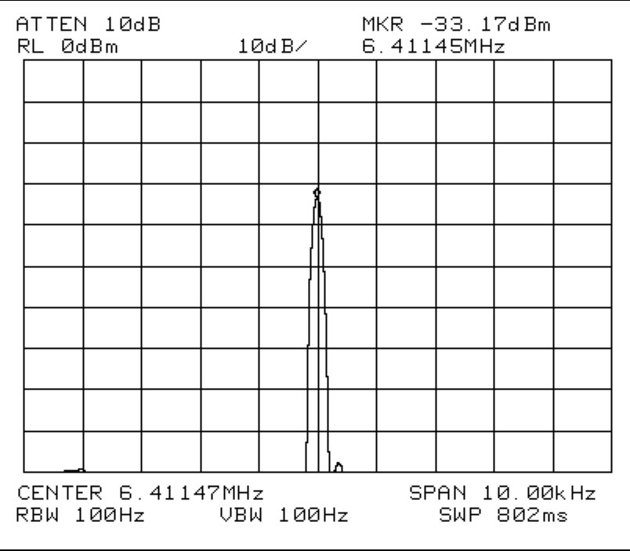
28nm CMOS based PLL components, Oscillator, TSPC Divider and VCSOM
장형준, 안양대학교 정보전기전자
Design and Measurement of NAND based PLL Components : PRESCALER, DIVIDER, PHASE FREQUENCY DETECTOR, CHARGE PUMP
2. Design and Measurement of True Single Phase Circuit (TSPC) Divider
3. Design and Measurement of Ring Oscillator
4. Design and Measurement of Voltage Controlled Self-Oscillating Mixer (VCSOM)
DIV2-CML
(Current Mirror Logic Divide-by 2)
PFD(PHASE FREQUENCY DETECTOR)+CP(CHARGE PUMP)
RING-Oscillator_RF_FET+DIV2_tspc(ESD)
DIV2-TSPC
(True Single Phase Circuit Divide by 2)
Oscilloscope Measurement at 0.194mA, 0.9V
- VCO-10KHz-REF10.6KHz
Measurement at 1.775mA, 1.67V
- Oscillator output:21GHz, -29dBm
DVID by 2 composed of
D-Flip-FLOPs based on NAND gates
PRESCALER
DIV8-TSPC
(True Single Phase Circuit Divide by 8)
VCSOM(Voltages Controlled Self-Oscillating Mixer)
Frequency Tuning : 243MHz/0.3V
PRESCALER composed of D-Flip-FLOPs based on NAND gates
Layout
Die Photography with 0.8mil bond wire
DiV-CML_TSPC8
DiV-CML_TSPC8
Down Converting Measurement
Input RF Signal:-0.3dBm,18GHz
Output IF Signal:-46dBm,781MHz
Oscillating Signal -18dBm,17.23GHz
Bias condition:9 mA, 1.651V
Span:100MHz
Up Converting Measurement
Input Signal :-50dBm,128MHz
Output RF Signal:-50dBm,17.32GHz
Oscillating Signal -25dBm,17.45GHz
Bias condition:9mA, 1.18V
Span:500MHz
High Frequency Measurement
Very sharp output spectrum in 100Hz span
Division ratio:16
Input:0dBm 17GHz
Output:-16dBm, 0.53MHz
Bias condition:15 mA , 1.2V
High Frequency Measurement
Very sharp output spectrum in 10 KHz span
Division ratio:192
Input:0dBm 1.23GHz
Output:-33dBm, 6.4MHz
Bias condition:11.4 mA, 1.4V
High Frequency Measurement
Very sharp output spectrum in 100 Hz span
Division ratio:12
Input:0dBm, 7.58GHz
Output:-20dBm,632MHz
Bias condition:8.21 mA , 2.1V
Low Frequency Digital Logic
Measurement
-Very sharp output spectrum in 100 Hz span
- Division ratio: 16 at MC=0
17 at MC=1 - Input signal: 0dBm 10MHz
- Bias condition:3.2mA, 1V
Conclusion
NAND logic circuit based components of PLL, Ring Oscillator, and VCSOM are designed, fabricated PLL using Samsung 28nm CMOS foundry process, measured on wire bonded COBs, analyzed, and demonstrated.
2. Integration of the circuits with SPI for the entire PLL system will be pursued.

